Slide 1


<Name>
<Date>

Slide 2

Outline
Executive Summary
Introduction
Methodology
Results
Conclusion
Appendix

Slide 3
Executive Summary
Summary of methodologies
Data Collection through API
Data Collection with Web Scraping
Data Wrangling
Exploratory Data Analysis with SQL
Exploratory Data Analysis with Data Visualization
Interactive Visual Analytics with Folium
Machine Learning Prediction
Summary of all results
Exploratory Data Analysis result
Interactive analytics in screenshots
Predictive Analytics result

Slide 4
Introduction
Project background and context
SpaceX has revolutionized the space launch industry by offering Falcon 9 launches at $62 million per mission, significantly undercutting competitors who charge upwards of $165 million. This cost advantage stems primarily from SpaceX's ability to recover and reuse the first stage of their rockets. Understanding whether a first stage will land successfully is therefore crucial for estimating launch costs, particularly valuable for companies considering competitive bids against SpaceX. Our project aims to develop a machine learning pipeline to predict first stage landing success.
Problems you want to find answers
Identify and analyze the key factors that influence successful rocket landings
Understand the relationships and interactions between different variables that affect landing success rates
Determine the optimal operating conditions required to maximize the probability of successful landings

Slide 5

Section 1

Slide 6
Methodology
Executive Summary
Data collection methodology:
Describe how data was collected
Perform data wrangling
Describe how data was processed
Perform exploratory data analysis (EDA) using visualization and SQL
Perform interactive visual analytics using Folium and Plotly Dash
Perform predictive analysis using classification models
How to build, tune, evaluate classification models

Slide 7
Data Collection Process
Key Steps:
API Data: Sent GET requests to SpaceX API, decoded JSON response, and converted to pandas dataframe using .json_normalize().
Data Cleaning: Handled missing values and inconsistencies.
Web Scraping: Scraped Falcon 9 launch records from Wikipedia using BeautifulSoup, parsed HTML tables, and converted to pandas dataframe.
Integration: Combined API and scraped datasets for analysis.
[GET Request → SpaceX API]
[Decode JSON → Pandas Dataframe]
[Clean Data]
[Scrape Wikipedia → Parse HTML Table → Pandas Dataframe]
[Combine Datasets]

Slide 8
Data Collection – SpaceX API
Request API and Parse SpaceX Launch Data
Send a GET request to the SpaceX API.
Filter Data for Falcon 9 Launches
Extract and filter the dataset to include only Falcon 9 launches.
Handle Missing Values
Identify and address missing or incomplete data points in the filtered dataset.
Parse and load the retrieved launch data into a structured format.
Apply appropriate methods (e.g., imputation, removal) to ensure data quality.
SpaceX provides a public API that allows data retrieval and utilization.
The API was accessed following the outlined flowchart, and the retrieved data was then stored.
📌 The source code is available on GitHub [here]

Slide 9
Data Collection - Scraping
Send a request to the Falcon 9 Launch Wikipedia page.
Extract column/variable names from the HTML table headers.
Parse the launch data tables and create a structured DataFrame.
SpaceX launch data can also be retrieved from Wikipedia.
The data is downloaded following the outlined flowchart and then stored.
📌 The source code is available on GitHub [here]

Slide 10
Data Wrangling
Send a request to the Falcon 9 Launch Wikipedia page.
Extract column/variable names from the HTML table headers.
Parse the launch data tables and create a structured DataFrame.
An initial Exploratory Data Analysis (EDA) was conducted on the dataset.
Summaries were generated for launches per site, orbit occurrences, and mission outcomes per orbit type.
Lastly, the landing outcome label was derived from the Outcome column.
📌 The source code is available on GitHub [here]

Slide 11
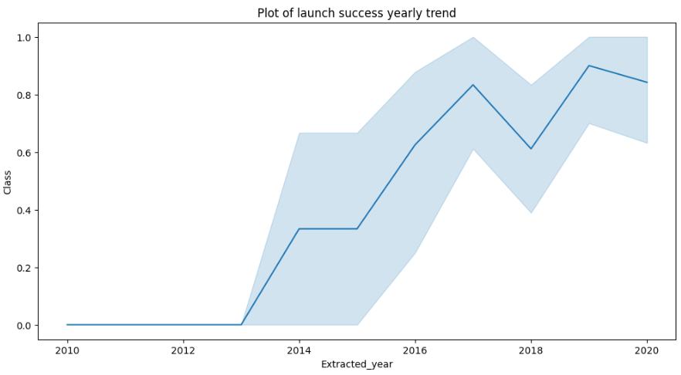
EDA with Data Visualization
The EDA with data visualization explored relationships between key launch factors.
Flight Number vs. Launch Site
Payload Mass vs. Launch Site
Success Rate vs. Orbit Type
Flight Number vs. Orbit Type
Payload Mass vs. Orbit Type
Yearly Success Trend
📌 The source code is available on GitHub [here]

Slide 12
EDA with SQL
The following SQL queries were executed:
Display the unique launch sites in the space mission.
Show 5 records where launch sites start with the string 'CCA’.
Calculate the total payload mass carried by boosters launched by NASA (CRS).
Find the average payload mass carried by booster version F9 v1.1.
List the date of the first successful landing outcome on the ground pad.
List the names of boosters that succeeded in drone ships with payload masses between 4000 and 6000.
Count the total number of successful and failed mission outcomes.
Identify booster versions that carried the maximum payload mass using a subquery.
Retrieve records showing the month names, failed landing outcomes on drone ships, booster versions, and launch sites for the months in 2015.
Rank landing outcomes (e.g., Failure on drone ship or Success on ground pad) between 2010-06-04 and 2017-03-20 in descending order.
📌 The source code is available on GitHub [here]

Slide 13
Build an Interactive Map with Folium
Summarize what map objects such as markers, circles, lines, etc. you created and added to a folium map
Explain why you added those objects
Add the GitHub URL of your completed interactive map with Folium map, as an external reference and peer-review purpose

Slide 14
Build a Dashboard with Plotly Dash
Summarize what plots/graphs and interactions you have added to a dashboard
Explain why you added those plots and interactions
Add the GitHub URL of your completed Plotly Dash lab, as an external reference and peer-review purpose

Slide 15
Predictive Analysis (Classification)
Summarize how you built, evaluated, improved, and found the best performing classification model
You need present your model development process using key phrases and flowchart
Add the GitHub URL of your completed predictive analysis lab, as an external reference and peer-review purpose

Slide 16
Results
Exploratory data analysis results
Interactive analytics demo in screenshots
Predictive analysis results

Slide 17

Section 2

Slide 18
Flight Number vs. Launch Site
Show a scatter plot of Flight Number vs. Launch Site
Show the screenshot of the scatter plot with explanations

Slide 19
Payload vs. Launch Site
Show a scatter plot of Payload vs. Launch Site
Show the screenshot of the scatter plot with explanations

Slide 20
Success Rate vs. Orbit Type
Show a bar chart for the success rate of each orbit type
Show the screenshot of the scatter plot with explanations

Slide 21
Flight Number vs. Orbit Type
Show a scatter point of Flight number vs. Orbit type
Show the screenshot of the scatter plot with explanations

Slide 22
Payload vs. Orbit Type
Show a scatter point of payload vs. orbit type
Show the screenshot of the scatter plot with explanations

Slide 23
Launch Success Yearly Trend
Show a line chart of yearly average success rate
Show the screenshot of the scatter plot with explanations

Slide 24
All Launch Site Names
Find the names of the unique launch sites
Present your query result with a short explanation here

Slide 25
Launch Site Names Begin with 'CCA'
Find 5 records where launch sites begin with `CCA`
Present your query result with a short explanation here

Slide 26
Total Payload Mass
Calculate the total payload carried by boosters from NASA
Present your query result with a short explanation here

Slide 27
Average Payload Mass by F9 v1.1
Calculate the average payload mass carried by booster version F9 v1.1
Present your query result with a short explanation here

Slide 28
First Successful Ground Landing Date
Find the dates of the first successful landing outcome on ground pad
Present your query result with a short explanation here

Slide 29
Successful Drone Ship Landing with Payload between 4000 and 6000
List the names of boosters which have successfully landed on drone ship and had payload mass greater than 4000 but less than 6000
Present your query result with a short explanation here

Slide 30
Total Number of Successful and Failure Mission Outcomes
Calculate the total number of successful and failure mission outcomes
Present your query result with a short explanation here

Slide 31
Boosters Carried Maximum Payload
List the names of the booster which have carried the maximum payload mass
Present your query result with a short explanation here

Slide 32
2015 Launch Records
List the failed landing_outcomes in drone ship, their booster versions, and launch site names for in year 2015
Present your query result with a short explanation here

Slide 33
Rank Landing Outcomes Between 2010-06-04 and 2017-03-20
Rank the count of landing outcomes (such as Failure (drone ship) or Success (ground pad)) between the date 2010-06-04 and 2017-03-20, in descending order
Present your query result with a short explanation here

Slide 34

Section 3

Slide 35
<Folium Map Screenshot 1>
Replace <Folium map screenshot 1> title with an appropriate title
Explore the generated folium map and make a proper screenshot to include all launch sites’ location markers on a global map
Explain the important elements and findings on the screenshot

Slide 36
<Folium Map Screenshot 2>
Replace <Folium map screenshot 2> title with an appropriate title
Explore the folium map and make a proper screenshot to show the color-labeled launch outcomes on the map
Explain the important elements and findings on the screenshot

Slide 37
<Folium Map Screenshot 3>
Replace <Folium map screenshot 3> title with an appropriate title
Explore the generated folium map and show the screenshot of a selected launch site to its proximities such as railway, highway, coastline, with distance calculated and displayed
Explain the important elements and findings on the screenshot

Slide 38

Section 4

Slide 39
<Dashboard Screenshot 1>
Replace <Dashboard screenshot 1> title with an appropriate title
Show the screenshot of launch success count for all sites, in a piechart
Explain the important elements and findings on the screenshot

Slide 40
<Dashboard Screenshot 2>
Replace <Dashboard screenshot 2> title with an appropriate title
Show the screenshot of the piechart for the launch site with highest launch success ratio
Explain the important elements and findings on the screenshot

Slide 41
<Dashboard Screenshot 3>
Replace <Dashboard screenshot 3> title with an appropriate title
Show screenshots of Payload vs. Launch Outcome scatter plot for all sites, with different payload selected in the range slider
Explain the important elements and findings on the screenshot, such as which payload range or booster version have the largest success rate, etc.

Slide 42

Section 5

Slide 43
Classification Accuracy
Visualize the built model accuracy for all built classification models, in a bar chart
Find which model has the highest classification accuracy

Slide 44
Confusion Matrix
Show the confusion matrix of the best performing model with an explanation

Slide 45
Conclusions
Point 1
Point 2
Point 3
Point 4
…

Slide 46
Appendix
Include any relevant assets like Python code snippets, SQL queries, charts, Notebook outputs, or data sets that you may have created during this project

Slide 47


